Slide 1
Applied Masters Oral Presentation
Satoshi Ido | April 2024

Slide 2
Contents
Problem 1: Effects of Autonomous Driving Factors on Heart Rate Variability: A Crossover Design Study
Problem 2: Analyzing Gas Consumption and
Driving Patterns
Introduction
Summary
Methods
Analysis① - Statistical Model
Analysis② - ANOVA Table & Results
Conclusion
Introduction
Summary
Methods
Analysis① - Visualizations
Analysis② - Paired t test
Analysis③ - Statistical Model
Conclusion

Slide 3
Problem
1
Effects of Autonomous Driving Factors on Heart Rate Variability (HRV): A Crossover Design Study

Slide 4

Introduction
The goal of this study is to explore how different combinations of transparency, recommended control mode, and system reliability impact HRV
8
combinations
Transparency (High or Low) ✖️ Control Mode (High or Low) ✖️System Reliability (High or Low)
Heart Rate

Slide 5

Introduction
2 virtual drives per person (4 min each)
4 combinations exposures per drive
→ 8 exposures per person
30 sec in middle of 1 min to measure
Risk of carry over effects
Simulation (Drive) 1st
Simulation (Drive) 2nd
switch
switch
switch
switch
switch
switch
measure
measure
measure
measure
measure
measure
measure
measure

Slide 6
Summary
Objective: Identify the most effective combinations of 3 factors in influencing HRV
Design: Crossover Design with two 4×4 Latin Squares
Statistical Model: First-order residual effects model

Slide 7

Methods
48 Participants will be recruited to have 2 simulations
Each participant will experience 2 simulated drives separated by a two-week washout period to mitigate carryover effects
Brief
Orientation
2 weeks washout
1st Simulation (Drive)
2nd Simulation (Drive)
①
②
③
④
⑤
⑥
⑦
⑧

Slide 8
Methods
There are 8 periods per person to examine three-factors (treatments) combinations, meaning we can implement all 8 treatment combinations to each person during 2 drives
For simplicity, alphabets(A-H) are used to denote specific treatments
A: High Transparency (+), High Recommended Control Mode (+), High System Reliability (+)
B: High Transparency (+), High Recommended Control Mode (+), Low System Reliability (-)
C: High Transparency (+), Low Recommended Control Mode (-), High System Reliability (+)
D: High Transparency (+), Low Recommended Control Mode (-), Low System Reliability (-)
E: Low Transparency (-), High Recommended Control Mode (+), High System Reliability (+)
F: Low Transparency (-), High Recommended Control Mode (+), Low System Reliability (-)
G: Low Transparency (-), Low Recommended Control Mode (-), High System Reliability (+)
H: Low Transparency (-), Low Recommended Control Mode (-), Low System Reliability (-)

Slide 9

Methods
We need to know how to assign 8 treatments equally while controlling an additional nuisance effect among participants created by overapplication of an specific order of treatments
Brief
Orientation
2 weeks washout
Simulation (Drive) 1st
Simulation (Drive) 2nd
eg →
①
a
②
c
③
d
④
b
⑤
f
⑥
h
⑦
e
⑧
g

Slide 10
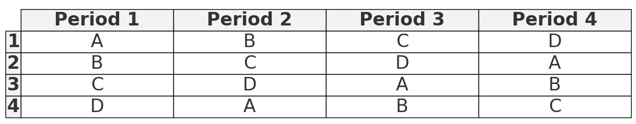
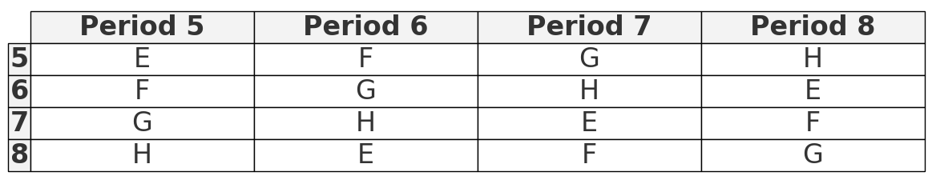
Methods
Crossover Design with two 4x4 Latin Squares to accommodate the study of 8 treatment combinations, anticipating variability between subjects and allowing for the assessment of carryover effects. This design with 48 subjects ensures that each treatment combination is tested an equal number of times across all subjects but in randomized orders. Every 4 participants, we restart the same random selections of treatment combinations
Randomly pick one
Randomly pick one
For 1st Simulation (Drive)
For 2nd Simulation (Drive)
Table 1
Latin Square for Treatments A, B, C, D (Periods 1 to 4)
Table 2
Latin Square for Treatments E, F, G, H (Periods 5 to 8)

Slide 11


Analysis① - Statistical Model
After collecting data, the response variable, HRV, can be analyzed using the First-order residual effects model specified below
where
y_ijk = HRV for the kth subject in the ith period receiving the jth treatment
μ = Overall mean HRV
P_i = Effect of the ith period (=block)
τ_j = Effect of the jth treatment
S_k = Effect of the kth subject (=block)
r_ij’ = First-order residual effect (for i != 1)
ε_ijk ∼ N(0,σ^2) (Random error term)
Note that we need to check some statistical assumptions after fitting this model

Slide 12
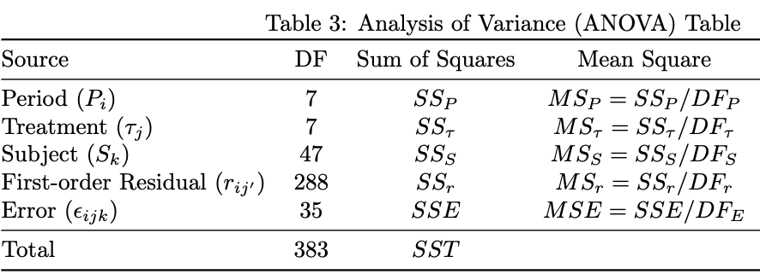
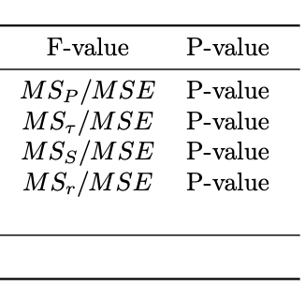
Analysis② - ANOVA Table & Results
The ANOVA table will be calculated to see whether each variable is statistically significant or not after running the first-order residual effects model provided above. Each formulas are display
The main effect is `treatment` effect

Slide 13
Conclusion
Through a methodical experimental design employing a crossover approach with Latin squares, we can ensure comprehensive exposure to all treatment combinations equally among participants, thereby facilitating a robust analysis of combinations of three factors effects on HRV

Slide 14
Problem
2
Analyzing Gas Consumption and Driving Patterns: Visualization and Statistical Techniques

Slide 15
Introduction
The goal of this study is to identify any insightful patterns within the data, focusing on visualization and statistical techniques
The visualization encompasses both original and derived data to explore observed patterns in overall and at-fill-up data.
The statistical model assesses the impact of these patterns on interval gallons, the volume of gas required to refill the tank during a specified period

Slide 16
Summary
Seasonal patterns of interval mileage and interval gallons over years.
The paired t-test suggests that the auto-generated numbers for interval mileage are often overestimated.
A multiple linear regression model is an appropriate model to analyze the interval gallons, aiming to predict future gas consumption.

Slide 17
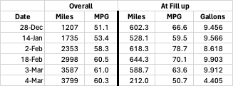
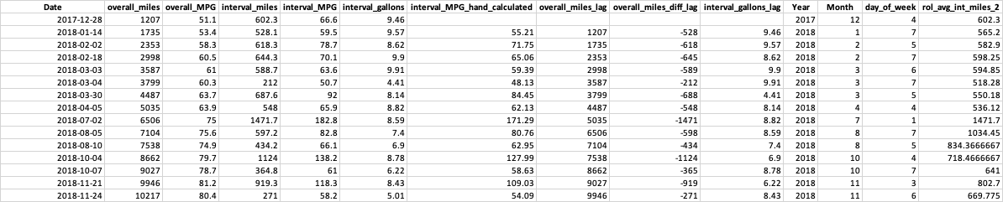
Methods
Data preprocess and derived data
prefix and renaming
Subdivision of “Date” information
Lag data
Rolling average data

Slide 18
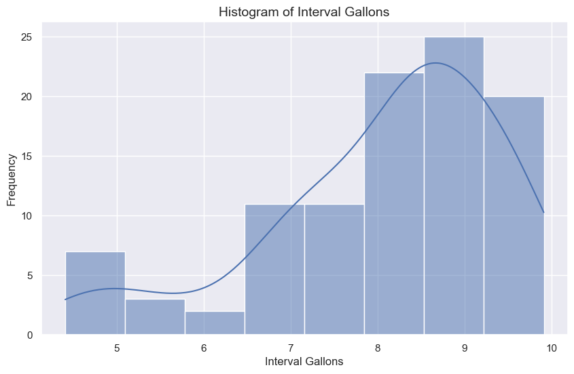
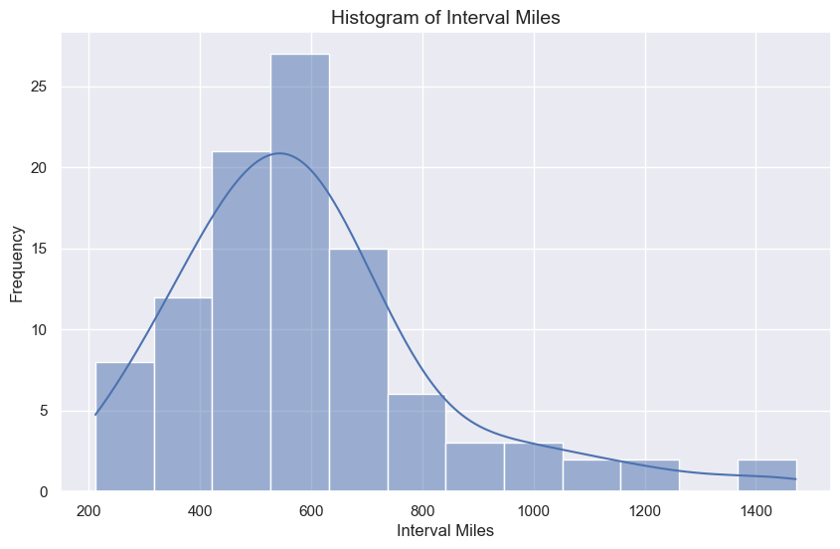
Analysis①(i) - Visualizations: Histogram of Interval Gallons and Interval of Miles
The most common range for:
Interval amount of gas filled up is between 8 to 10 gallons
Interval mileage typically ranges between 400 to 700 miles per interval
Histogram of Interval Gallons
Histogram of Interval Mileage

Slide 19
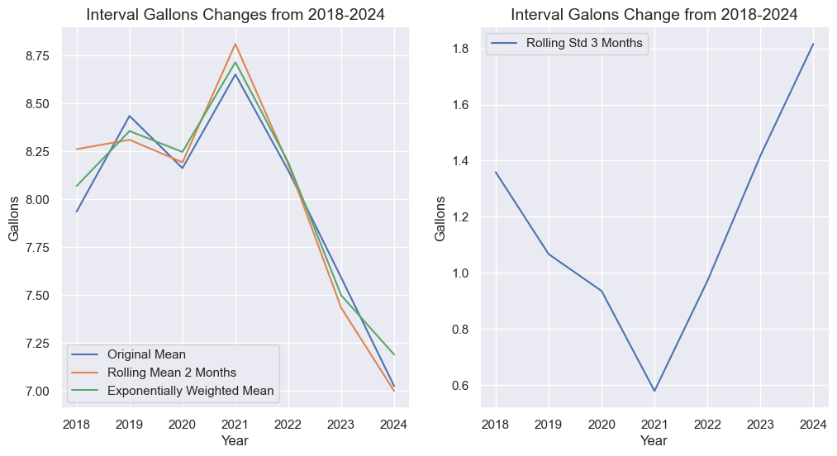
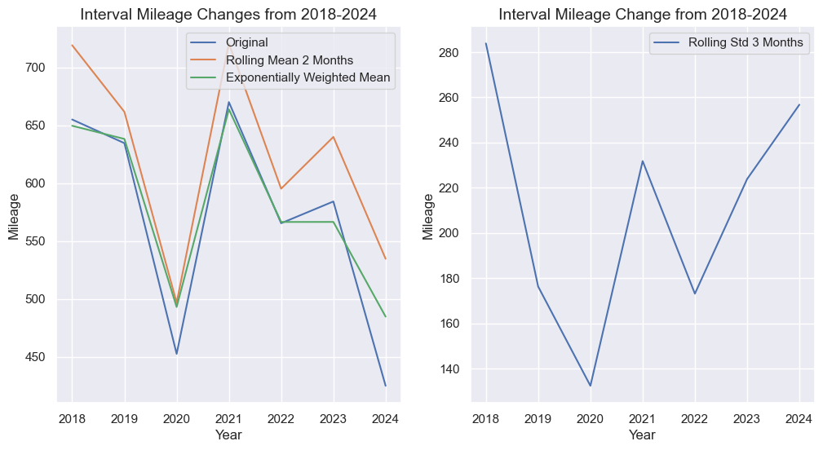
Analysis①(ii) - Visualizations: Interval gallons and average interval miles by year
In 2020, mileage and gas consumption decreased
In 2021, we observed the highest miles driven and gas filled within the period studied. The EWSD plot reveals minor variations in interval gallons filled, indicative of predominantly large amount of gas consumptions
Interval Gallons by Year
Interval Mileage by Year

Slide 20
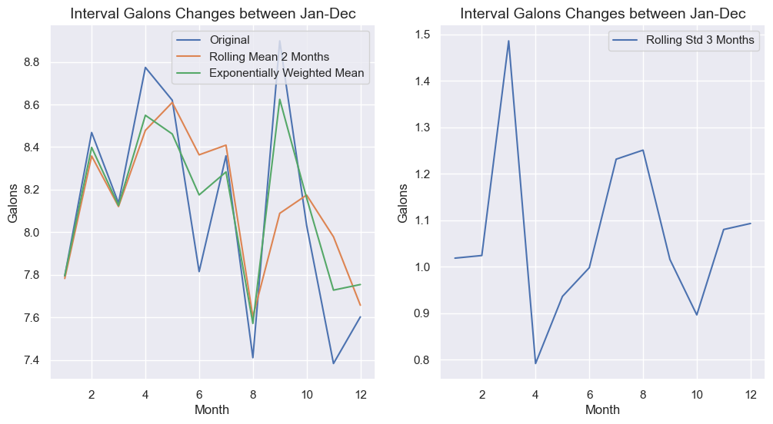
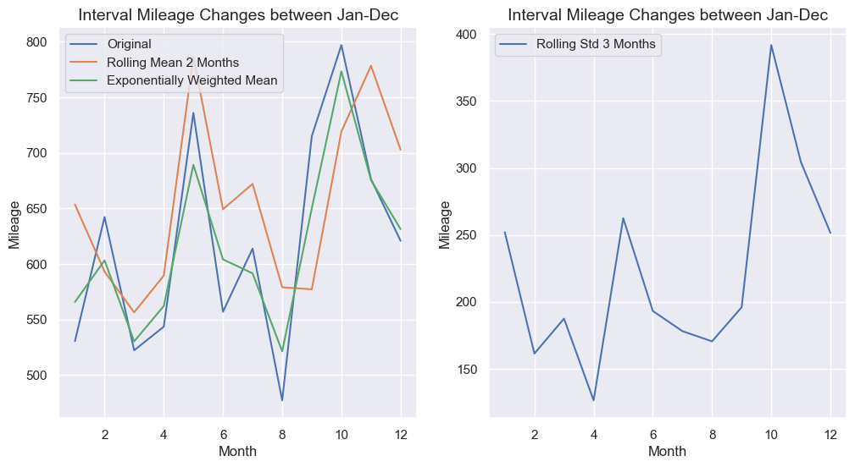
Analysis①(iii) - Visualizations: Interval gallons and average interval miles by month
Long-distance driving and significant gas usage occur especially from May, and September through November, correlating with increased activities during comfortably warmer months
A distinctive feature between spring and fall activities is the higher EWSD in fall, suggesting a mix of short and long-distance driving.
Interval Gallons by Month
Interval Mileage by Month

Slide 21
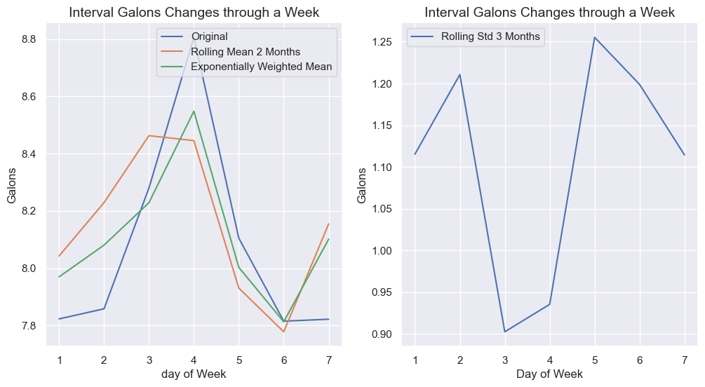
Analysis①(iv) - Visualizations: Interval gallons and average interval miles by day of week
The average interval gallons filled up over the week reveals that refueling predominantly occurs mid-week, specifically on Wednesday or Thursday (weekday numbers are labeled as monday = 1 and sunday = 7)
Interval Gallons by day of week

Slide 22
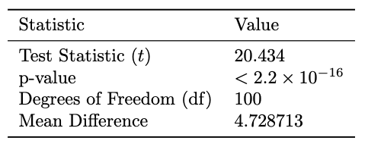
Analysis② - Paired T Test
Given the extremely low p-value, we reject the null hypothesis. This indicates significant statistical evidence to conclude that the computer-generated interval MPG is, on average, 4.73 MPG greater than the actual interval MPG.
Null hypothesis (H0): The mean difference between the computer-generated MPG and the actual MPG is zero
Alternative hypothesis (H1): The mean difference between the computer-generated MPG and the actual MPG is greater than zero, indicating that the computer-generated MPG values are typically higher than the actual MPG values
Paired t-test Results

Slide 23
Analysis③ - Multiple Linear Regression Analysis of Gas Consumption
The relationship between gas usage over time intervals (measured in gallons) and lag of miles and lag of gallons displayed below
where
Y_hat signifies the Box-Cox transformed interval gallons, serving as the dependent variable
51.927 is the intercept of the model, representing the expected transformed interval gallons when other predictors are not considered
X_(gallons, lag) is the 1-period lag of interval gallons, serving as an explanatory variable to measure the influence of past gas usage on current levels
2.303 quantifies the effect of a one-unit increase in X_lag on Y_hat, holding other factors constant
log(X_(miles, lag)) is the natural log transformation of the 1-period lag in interval mileage data, employed to stabilize the variance and achieve a linear relationship with the response variable
−5.962 measures the influence of a one-unit change in log(X_(miles, lag)) on Y_hat
ε embodies the error term, encapsulating random fluctuations not explained by the regression model
Statistical Assumption Check and the key process before interpretation of expected response Y are included in appendix

Slide 24
Conclusion
Through these data visualization, specific patterns can be seen in week, month, and year ranges
The application of a paired t-test revealed a statistically significant overestimation in computer-generated interval mileage compared to actual measurements, indicating a systematic bias in the auto-generated mileage figures
The employed multiple linear regression model stands out for its simplicity and interpretability, proving to be a fitting method to predict future gas consumption. Future work could benefit from integrating more nuanced data and advanced modeling techniques to enhance the accuracy and applicability of consumption predictions.

Slide 25
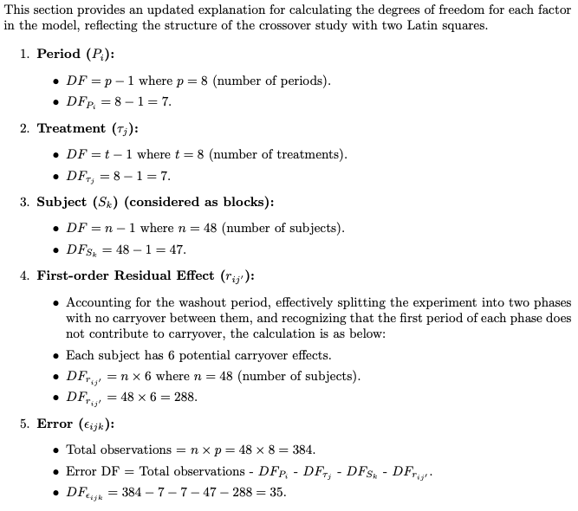
Appendix
This list provides an explanation for calculating the degrees of freedom for each factor in the model, reflecting the structure of the crossover study with two Latin squares.

Slide 26
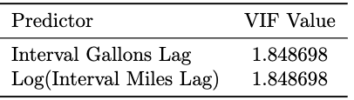
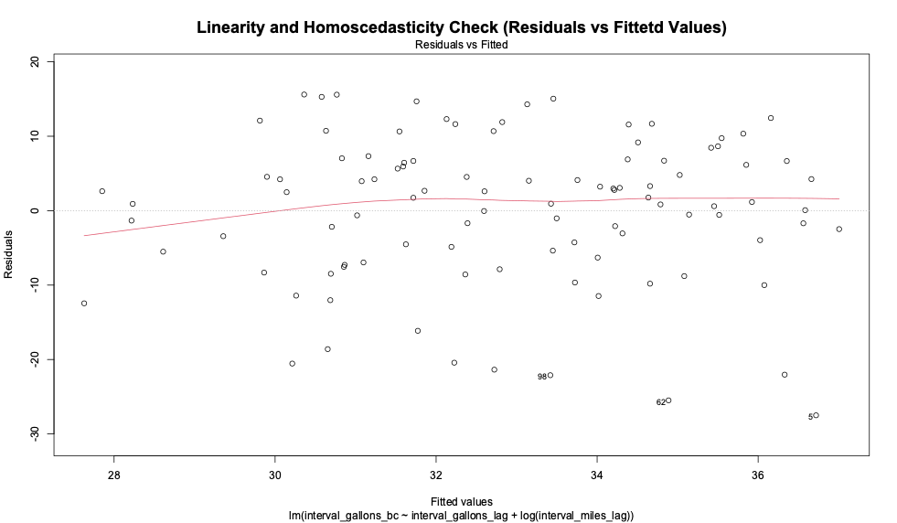
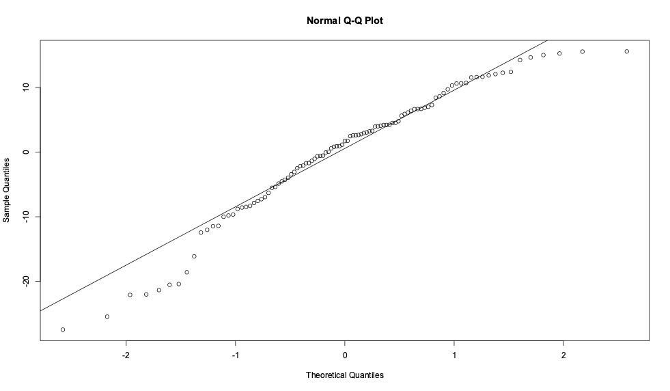
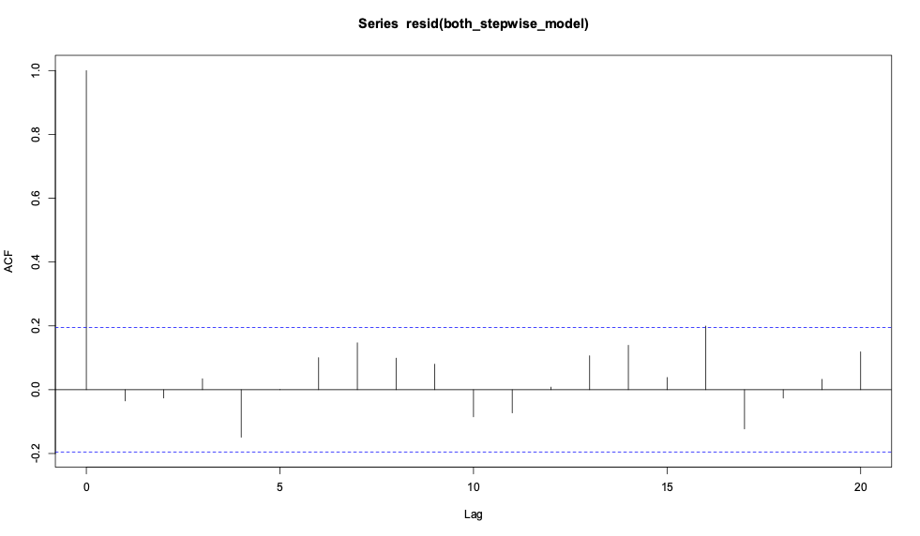
Appendix
Statistical Assumptions Check for Multiple Linear Regression as below
Variance Inflation Factor (VIF)
Linearity and Homoscedasticity Check - Residual Plot
Normality Check - QQ Plot
Independence Autocorrelation Check

Slide 27
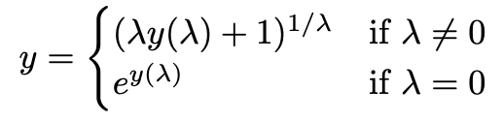
Appendix
To interpret the expected future gallons in their original scale, it needs to be applied the inverse of the Box-Cox transformation to the predicted values as below

